Slide 1

Implementation Of Baroque Chess
Team Members:
Naga Venkata Bharath Lanka
Anusha Jami

Slide 2
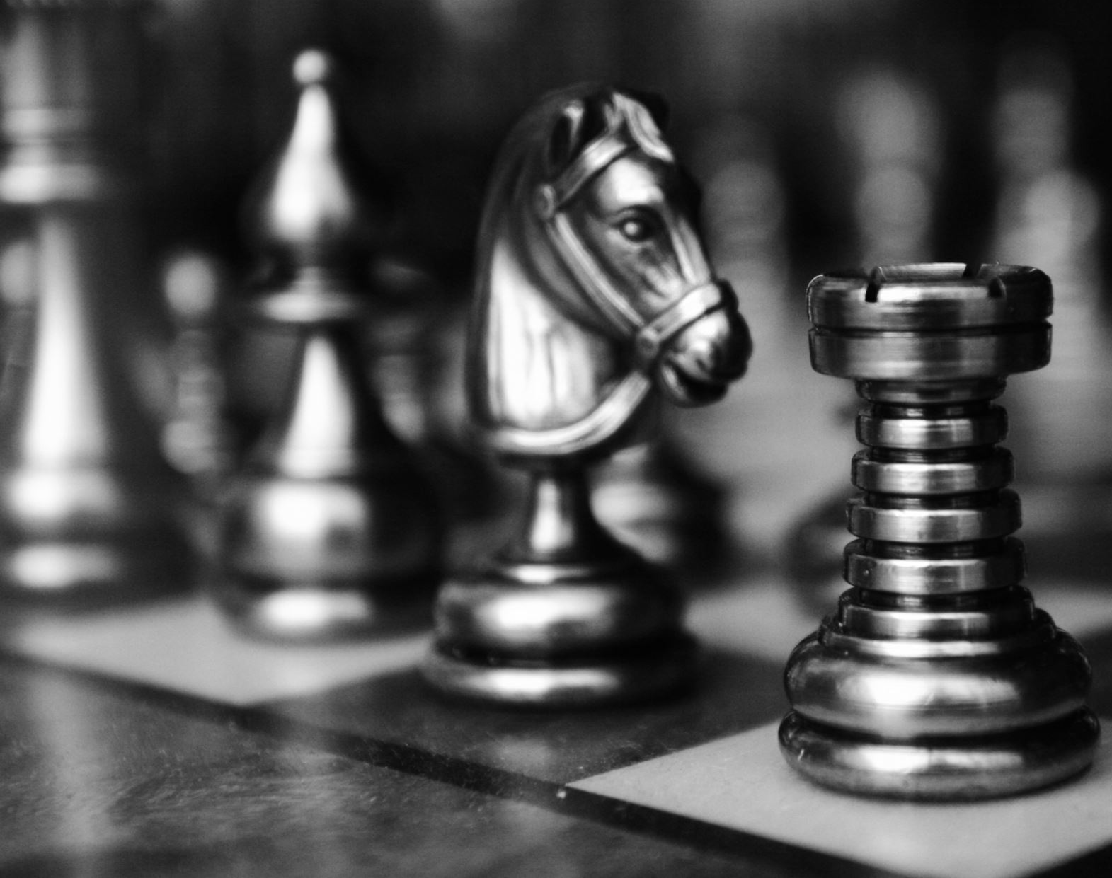
Project Topic
Implementation Of Baroque Chess Agent Using Artificial Intelligence Algorithms

Slide 3

Statement of Project Objectives
Develop a Baroque Chess AI capable of making strategic and optimal moves.
Implement the minimax algorithm with alpha-beta pruning to enhance the efficiency of the AI decision-making process.

Slide 4
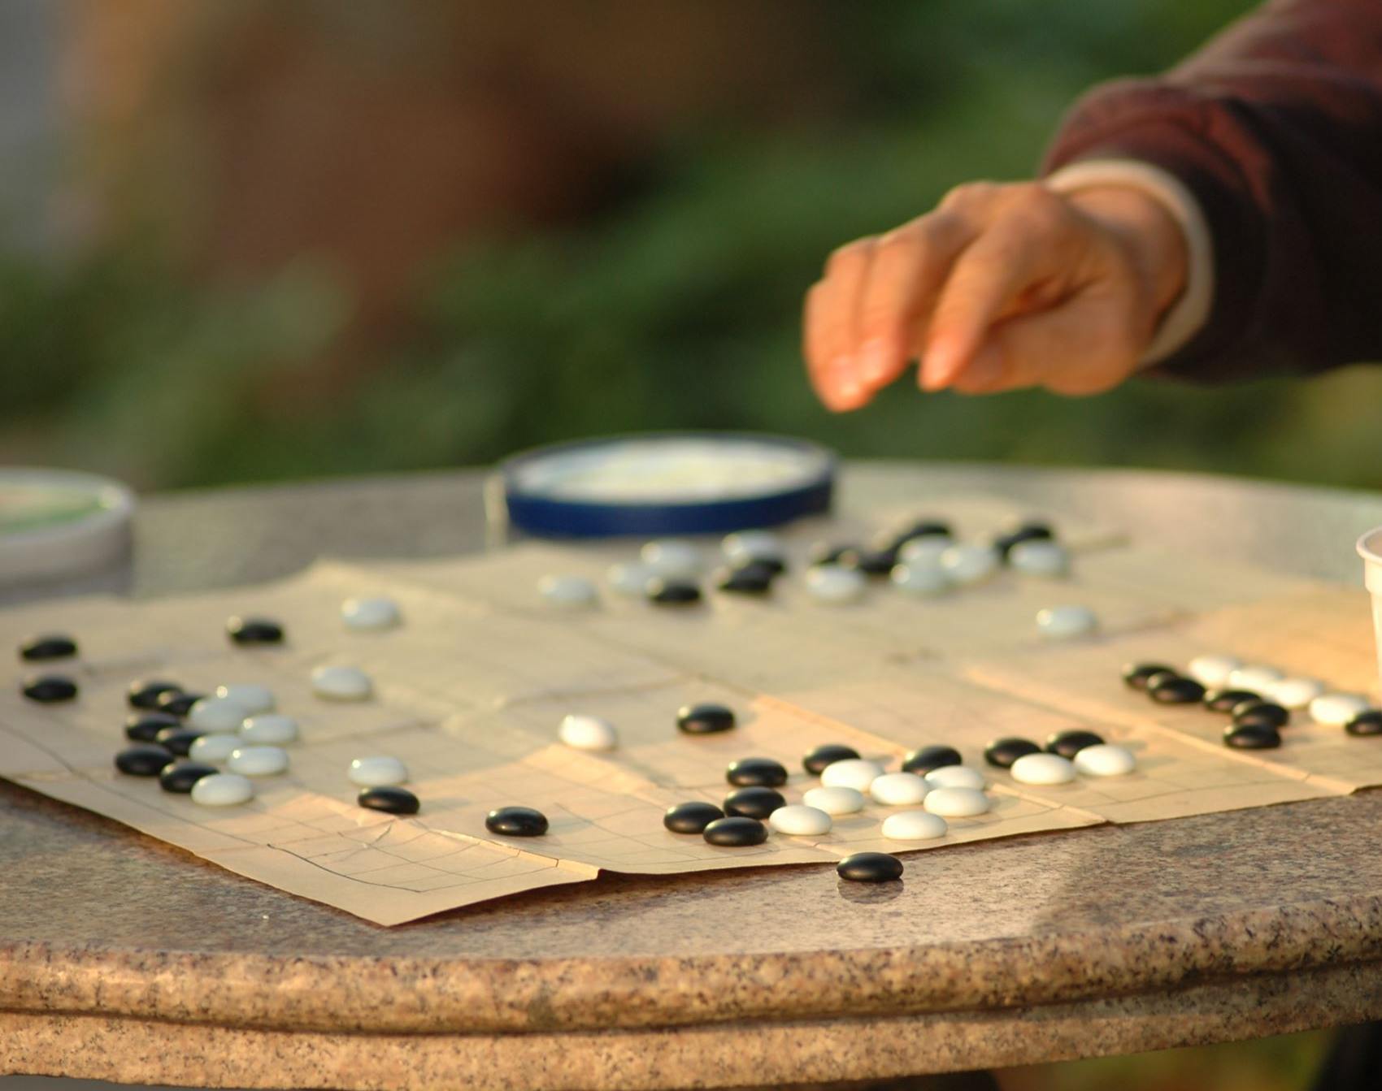
Approach
Utilize a programming language suitable for AI development, such as Python.
Implement the Baroque Chess rules and board representation.
Develop a minimax algorithm with alpha-beta pruning to navigate through the game tree efficiently.

Slide 5

Deliverables
Fully functional Baroque Chess AI capable of playing against human players or other AIs.
Source code repository containing the AI implementation, with detailed documentation.
Documentation on AI algorithms and strategies used in the project.

Slide 6

Evaluation Methodology
Assess the AI's winning percentage against human players.
1
Evaluate its ability to adapt to different playing styles.
2
Measure the efficiency of decision-making algorithms.
3
Test the robustness of the AI in handling various game scenarios
4

